Slide 1
Unit 203: Electrical installations technology
Trunking systems

Slide 2
Trunking systems
Three main types:
metal (steel)
PVC
mini trunking.

Slide 3
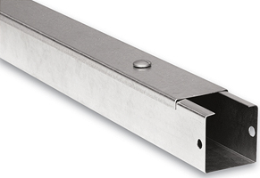
Trunking systems
Steel trunking
Advantages:
affords conductors good mechanical protection
can accommodate many cables of different sizes
permits easy rewiring
minimises fire risks
can be utilised as the circuit protective conductor.
Disadvantages:
expensive compared with some other systems
requires skill to fabricate and install
difficult to make it gas- and water-proof
liable to corrosion when subject to acid, alkali and other fumes.

Slide 4
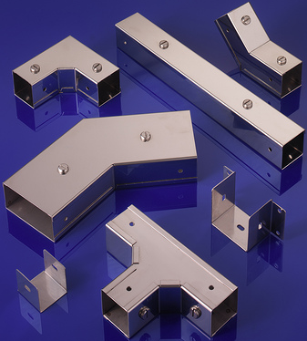
Trunking systems

Slide 5
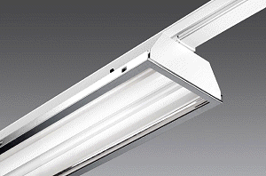
Lighting trunking

Slide 6
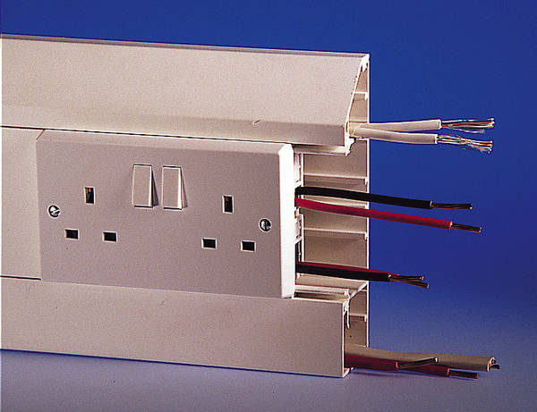
Skirting trunking

Slide 7
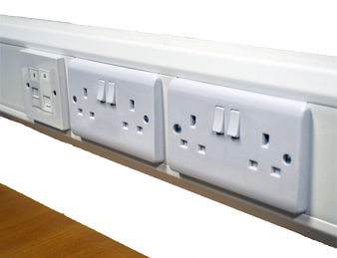
Dado trunking

Slide 8
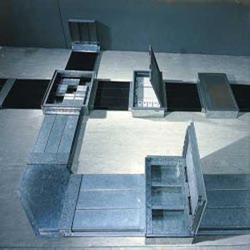
Underfloor trunking

Slide 9
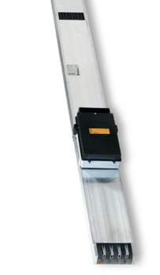
Busbar trunking

Slide 10

Rising main trunking

Slide 11
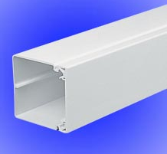
PVC trunking

Slide 12
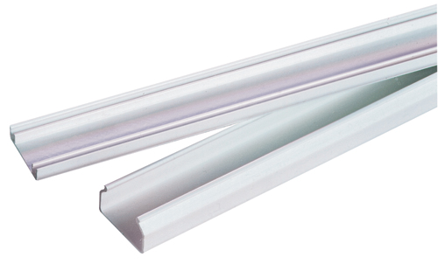
PVC mini trunking

Slide 13
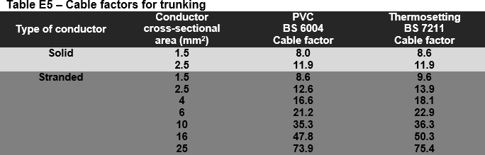
Sizing trunking systems

Slide 14
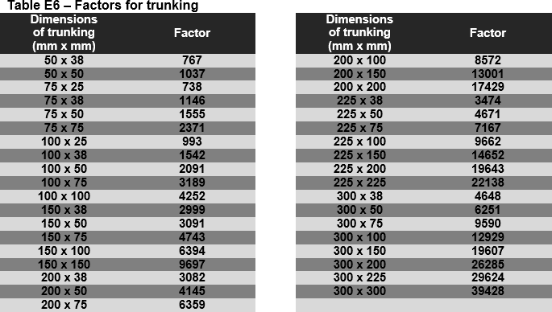
Sizing trunking systems

Slide 15
Sizing conduit systems
Example 1. The following PVC insulated cables are to be installed in steel cable trunking:
10 off 4mm² cables
10 off 6mm² cables
10 off 10mm² cables.
Calculate the size of cable trunking that would be suitable for this application.
Cable factors from Table E5 (On-Site Guide)
10 off solid core 4mm² | = | 16.6 x 10 | = | 166
10 off solid core 6mm² | = | 21.2 x 10 | = | 212
10 off solid core 10mm² | = | 35.3 x 10 | = | 353
Cable factors total | = | 166 + 212 + 353 | = | 731
From On-Site Guide Table E6, size required | = | 75 x 25mm

Slide 16
Unit 203: Electrical installations technology
The End

